Slide 1
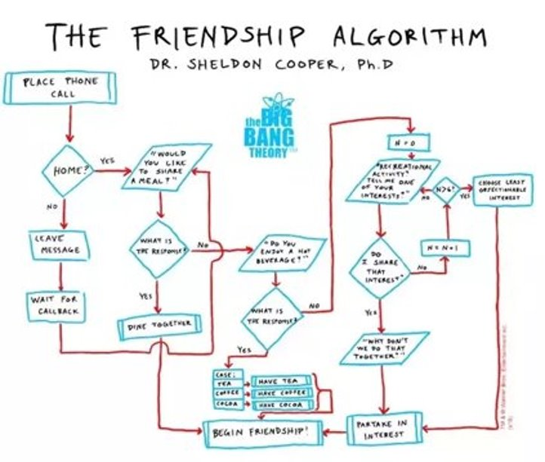

Switch Branching and Strings/Chars

Slide 2
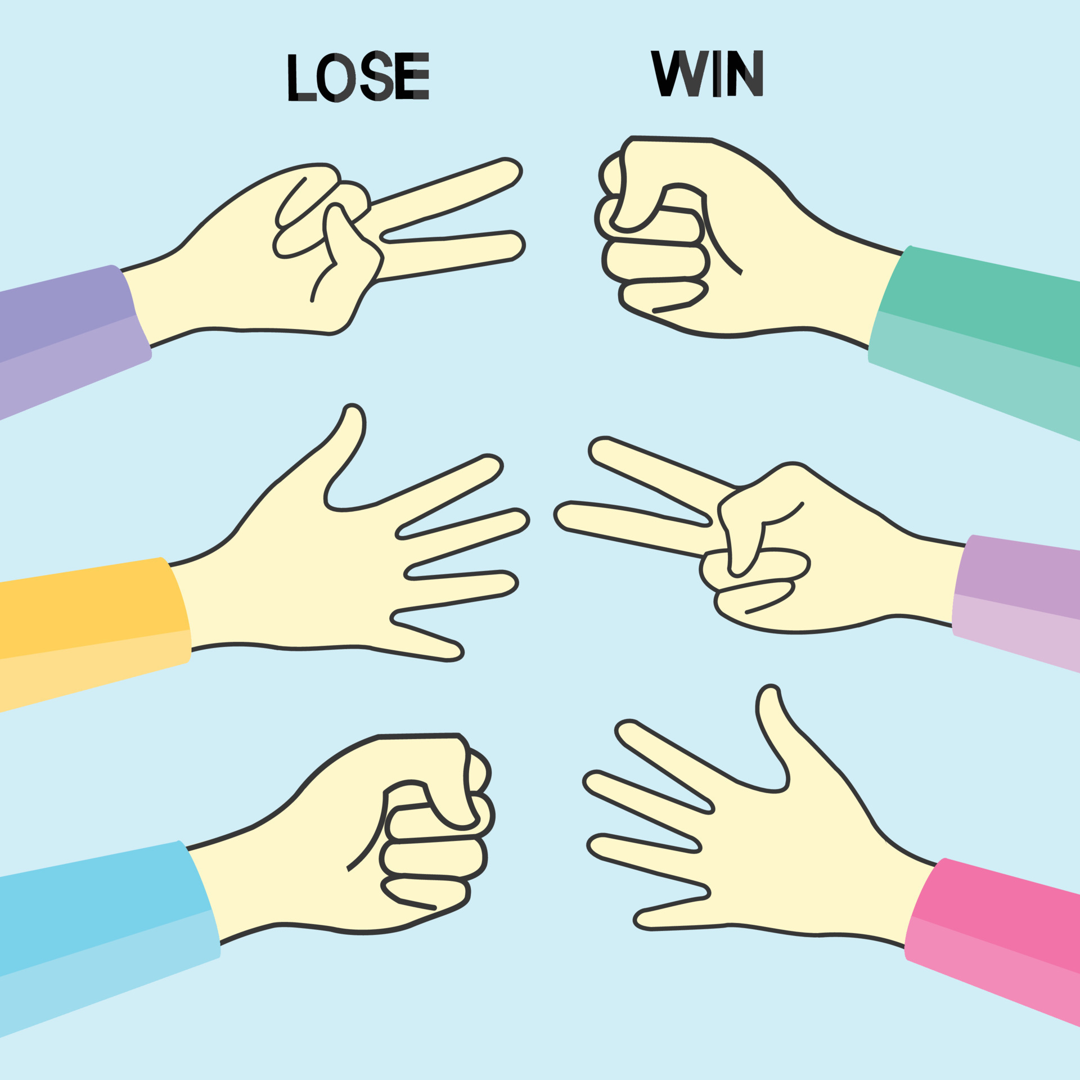
Today
Quiz 01 Results will be posted this weekend
Goals
Understand, Analyze and Apply Object Oriented Programming Fundamentals and Conditional Statements
Standard Library Packages, Classes and Methods
String and Character Classa
characters and Strings
Switch statements

Slide 3
Rock Paper Scissors
public static void main(String[] args) {
Scanner scanner = new Scanner(System.in);
System.out.print("Enter Player 1 choice (rock, paper, scissors): ");
String player1 = scanner.next().toLowerCase();
System.out.print("Enter Player 2 choice (rock, paper, scissors): ");
String player2 = scanner.next().toLowerCase();
if (player1.equals(player2)) {
System.out.println("It's a tie!");
} else if ((player1.equals("rock") && player2.equals("scissors")) ||
(player1.equals("scissors") && player2.equals("paper")) ||
(player1.equals("paper") && player2.equals("rock"))) {
System.out.println("Player 1 wins!");
} else {
System.out.println("Player 2 wins!");
}
scanner.close();
}
How do you read this code?

Slide 4
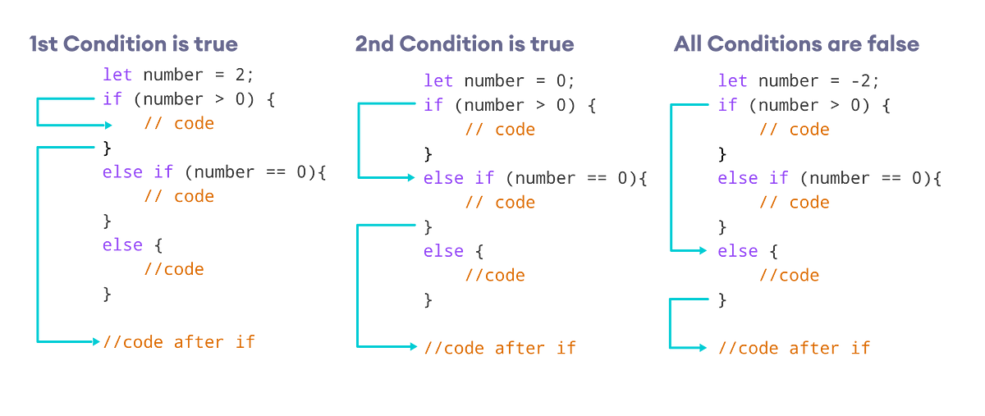
Testing conditions
When testing conditions you should have test data for each condition and the edge cases.
test cases
test case
1 test cases

Slide 5
Logical Operators
Complex condition statements
Use logical operators to combine conditions into complex statements
Logical operators are used to compare values and create compound boolean expressions
C evaluates all expression that include relational operators, equality operators, and/or logical operators to true or false
 | Simple Conditions
> | greater than
< | less than
>= | greater than or equals
<= | less than or equals
== | equality
!= | inequality
 |  | Complex Conditions
|| | or | True if at least one of the boolean operands is true, otherwise false
&& | and | True if and only if both boolean operands are true, otherwise false
! | not | Reverses the logical value of the expression

Slide 6
Logical Tables and &&
Logical AND &&​
Operand 1​ | Operand 2​ | && Result​
false | false | false
false | true​ | false
true​ | false | false​
true​ | true​ | ​true​
Operator | Name | Description
&& | Logical and | Returns true if both statements are true
bool snowing = true;
bool icyRoads = true;
if (snowing && icyRoads)
{
println ("Stay home");
}
else
{
println ("Go to class");
}
bool snowing = false;
bool icyRoads = true;
if (snowing && icyRoads)
{
println ("Stay home");
}
else
{
println ("Go to class");
}
bool snowing = false;
bool icyRoads = false;
if (snowing && icyRoads)
{
println ("Stay home");
}
else
{
println ("Go to class");
}
Evaluates to false
Evaluate to true

Slide 7
Logical Tables or ||
Logical OR ||​
Operand 1​ | Operand 2​ | || Result​
false | false | false
false​ | true​ | true​
true​ | false | true​
true​ | true​ | true​​
Operator | Name | Description
|| | Logical or | Returns true if one of the statements is true
bool snowing = true;
bool icyRoads = true;
if (snowing || icyRoads)
{
println ("Stay home");
}
else
{
println ("Go to class");
}
bool snowing = false;
bool icyRoads = true;
if (snowing || icyRoads)
{
println ("Stay home");
}
else
{
println ("Go to class");
}
bool snowing = false;
bool icyRoads = false;
if (snowing || icyRoads)
{
println ("Stay home");
}
else
{
println ("Go to class");
}
Evaluates to true
Evaluates to false

Slide 8
Logical Tables not: !
Operator | Name | Description
! | Logical not | Reverse the result, returns false if the result is true
bool snowing = true;​
if (!snowing) ​
{​
println ("Go to class");​
}
else
{
println ("Stay home");​
}
bool snowing = false;​
if (!snowing) ​
{​
println ("Go to class");​
}
else
{
println ("Stay home");​
}
expr1 | !expr1
true​ | false
false | true​

Slide 9
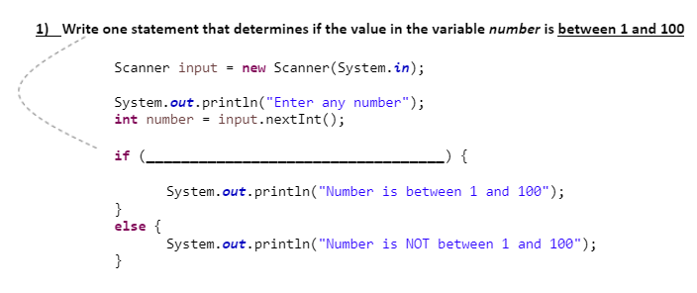
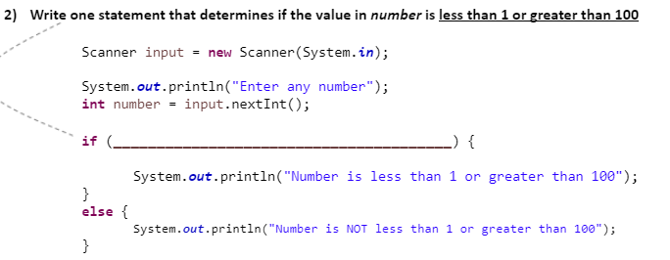
Practice
1 to 100
And including 1 and 100

Slide 10
Result
And including 1 and 100
(number >= 1 && number <= 100) {
(number < 1 || number > 100) {

Slide 11
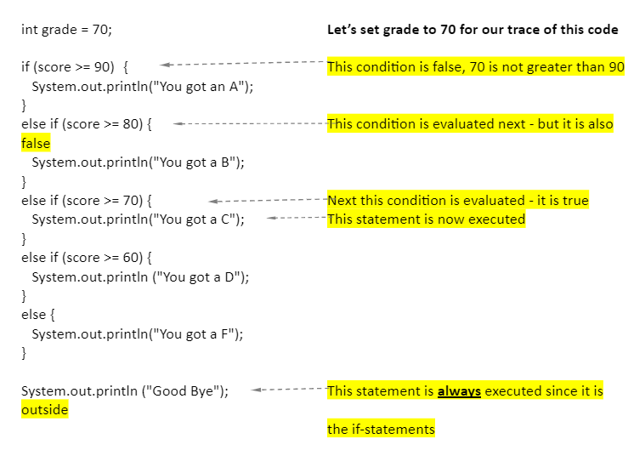
Understanding and Tracking Code
This is an important skill not just for school but in industry as you try to understand someone else’s code.

Slide 12
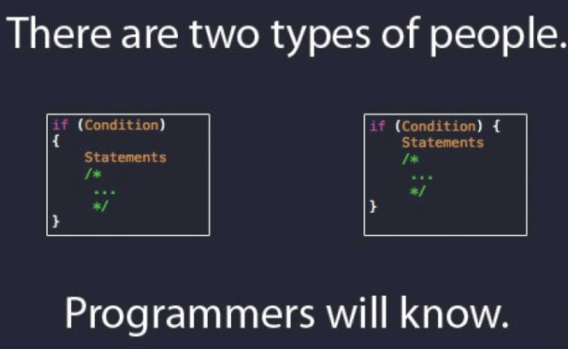
Quality Coding
if (condition1)
{
actions
}
elseif (condition2)
{
actions
}
elseif (condition3)
{
actions
}
else
{
actions
}
It is important to make your code readable and maintainable.
Curly braces may be omitted if there is only one statement in the "then” part or "else" part BUT use curly braces, it helps make the code easier to modify, less error prone
Indent the body statements for if-statements to increase readability (in code and pseudocode)
if (condition)
{
actions
}
if (condition)
{
actions
}
else​
{
actions
}​
There is a ternary operator (? :) to perform the task of if...else statement. It is a shorthand way to check the condition. In order to make our code readable we will not be using this in our class.

Slide 13
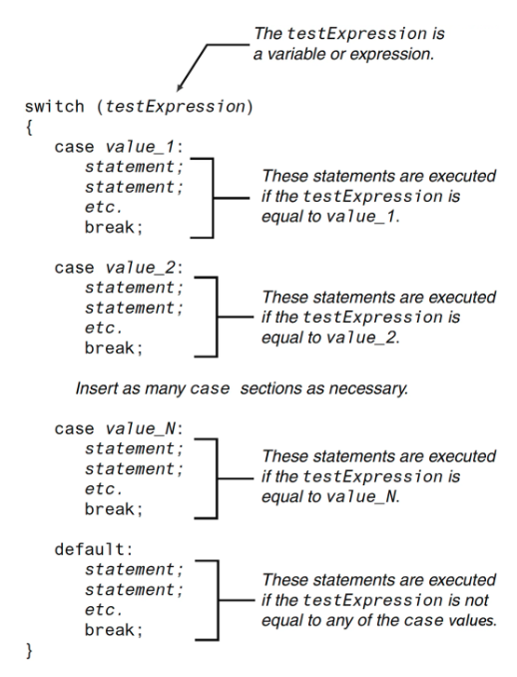
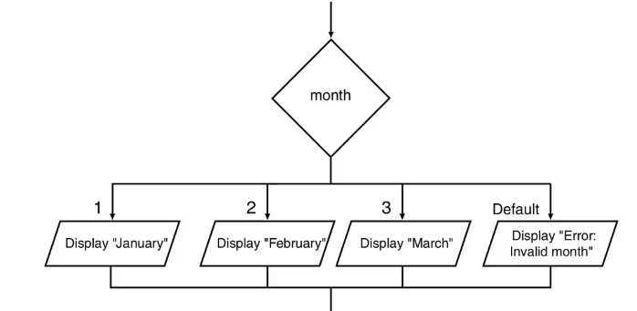
Switch Statement for Constant Expression
The switch statement lets the value of a variable or expression determine to where the program will branch.
The switch "testExpression" is evaluated
If one of the case "values" matches the value of the switch "expression"
The statements for that case are executed
Execution stops when a break statement is reached or the end of the switch statement is reached
If no case "values" match the value of the switch "expression"
a default case is executed if it exists
General Form:
Reserved words:
Switch
Case
break

Slide 14
Break and default
int numDay=6;
switch (numDay){
case 1 :{
System.out.println("Yeah! we have Java class on Monday.");
break;
}
case 2 :{
System.out.println("Its Tuesday and one more day until Java class again.");
break;
}
case 3 :{
System.out.println("Its Wednesday and time for Java.");
break;
}
case 4 :{
System.out.println("Its Thursday and I miss Java class.");
break;
}
case 5 :{
System.out.println("TGIF, but I will work on some Java.");
break;
}
case 6 :
case 7 :{
System.out.println("Hurray, Its the weekend! Write Java code.");
break;
}
default :{
System.out.println("Wrong entry!");
}
}//end switch
break statement
End a case
Use at end of each case to terminate the case and go to the end
If the case that was entered does not contain a break - the code continues to next case
We say the code "falls through" to next case
Above example can be written as
Only use breaks in switch statement
What would happen if this break was removed?
"The "default" statement:
Is optional
Used to perform some action if none of the cases match the switch expression
6 falls through and runs same code as 7
Default if no other case above matches

Slide 15
Example switch
switch (numDay){
case 1 :{
System.out.println("Yeah! we have Java class on Monday.");
break;
}
case 2 :{
System.out.println("It's Tuesday. 1 more day until Java class again.");
break;
}
case 3 :{
System.out.println("Its Wednesday and time for Java.");
break;
}
case 4 :{
System.out.println("It's Thursday and I miss Java class.");
break;
}
case 5 :{
System.out.println("TGIF, but I will work on some Java.");
break;
}
case 6 :
case 7 :{
System.out.println("Hurray, Its the weekend! Write Java code.");
break;
}
default :{
System.out.println("Wrong entry!");
}
}//end switch
The switch-expression must always
be enclosed in parentheses
yield a value of char, byte, short, or int type
The case value must be same data type as switch expression.

Slide 16

Rules: switch and case
The switch "expression"
must always be in parentheses
must evaluate to a value of type char, String, byte short, int, long
The case values - "value1", "value2", etc.
Are constants expressions
Cannot contain variables
switch (x > 1) //Not allowed - evaluates to a boolean value
switch (x == 2) // Not allowed - another boolean expression
case (x+1): System.out.println("...."); // not valid

Slide 17
Explore Code
switch (choice)
{
case 'A':
System.out.println("You entered A.");
break;
case 'B':
System.out.println("You entered B.");
break;
case 'C':
System.out.println("You entered C.");
break;
default:
System.out.println("That's not A, B, or C!");
}
After class import and explore SwitchDemo.java
Add a case so that a D or F prints out you must retake the class.
Then update the default case to print out “That is not an A, B, C, D, or F!”

Slide 18
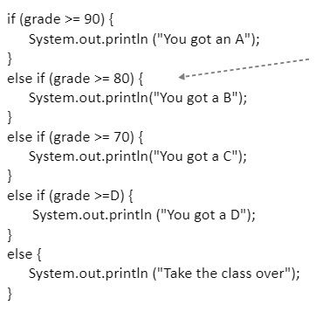
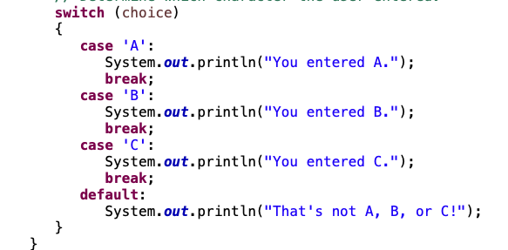
If or Switch
Use an If statement when need to test for boolean conditions
Use a Switch statement in situations where matching a constant value of type char or int.

Slide 19
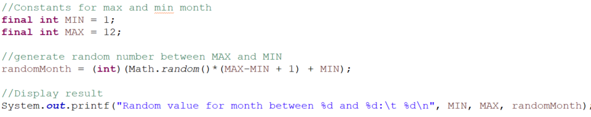
Display Month Text
Add code to display the word for the month that was randomly selected where 1 is January, 2 is February, 3 is March and 4 is April. You can stop at April.
More Practice by adding a case statement to print out the month for that integer as a String.

Slide 20
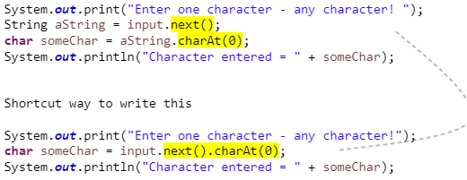
Reading Characters from Keyboard
Note: the Scanner DOES NOT have a nextChar() method
Two methods are needed to read a character
First use the Scanner's - next() method to read the string
Then use String's - charAt() method to read a character
Can do in two steps or in one step
Put in your code

Slide 21
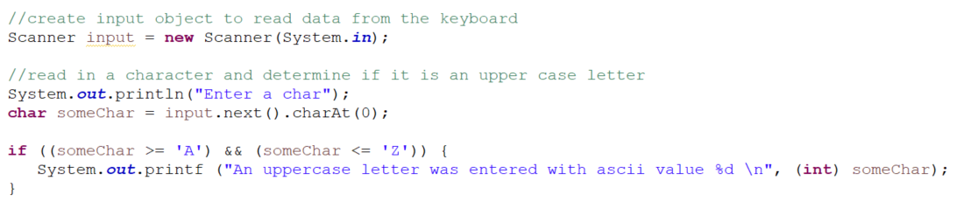
Comparing and Testing Characters
Use relational operators to compare two characters just like you do for numbers
The Unicode ACII decimal value is what is used in the comparison
How could you print char that was inputted? What is the format specifier for a char?
Prints ascii decimal value

Slide 22
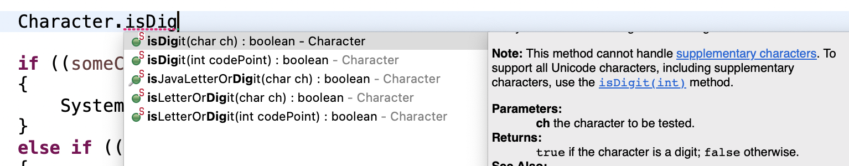
Character Class
Use the static methods in to test characters
Contains a bunch of methods that do tests on characters
Like the Math class - you don't create an object of this class
Explore these methods
Character.isDigit(someChar)
Character.isLetter(someChar)
Character.isLetterOrDigit(someChar) // True if someChar is letter or digit
Character.isLowerCase(someChar);
Character.isUpperCase(someChar);
Explore these
Character.toLowerCase(someChar);
Character.toUpperCase(someChar);
What do the methods return?
What do the methods return?
Type the following

Slide 23
Is char numeric
We can check if a char is numeric, uppercase or lowercase. ASCII table
if ((someChar >='1') && (someChar <='9'))
{
System.out.printf ("A lowercase letter was entered with ascii value %d \n", (int) someChar);
}
The Character class method will return true or false if you use their method isDigit.
if((Character.isDigit(someChar)))
{
System.out.printf ("You have entered a number with ascii value %d \n", (int) someChar);
}
Returns boolean and if runs based on true

Slide 24
Strings and chars
if((Character.isDigit(someChar)))
{
System.out.printf ("You have entered a number with ascii value %d \n", (int) someChar);
}
if(someChar == '5')
{
System.out.printf ("chars are the same");
}
After adding this code set breakpoint at this line and run the debugger and enter 5 for the char.
See next two slides on how to use the debugger
Explore Strings and chars. What is the difference in the data type? What does a char hold? What can a String hold? What are the naming conventions of the data types? Put discoveries in the chat.

Slide 25
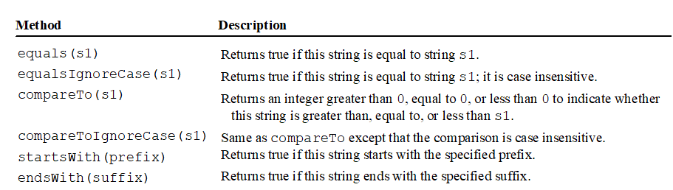
Comparing Strings
You would think using the equality operator (==) with strings is how you compare two strings but if you use the equality operator to compare two strings, it is not doing what you think all the time.
Instead use methods to compare strings:
But why can we compare chars? ‘a’==’a’

Slide 26
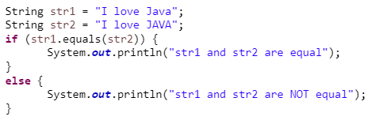
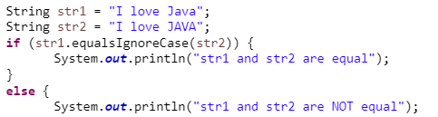
Examples equals and equalsIgnoreCase
What executes?
Put in your code and run debugger
What executes?
Update your code and run debugger

Slide 27

Compare strings
compareTo(s1)
Returns an integer:
> 0 if string is greater than s1
= 0 if string is equal to s1
< 0 if string is less than s1
The following returns -4 so str1 is less than str2
Put in your code

Slide 28
Reading a String from the Standard Input (Keyboard)
next() method reads string until a white space character is reached.
Scanner input = new Scanner(System.in);
System.out.print("Enter three words separated by spaces: ");
String word1 = input.next();
String word2 = input.next();
String word3 = input.next();
System.out.println("word1 is " + word1);
System.out.println("word2 is " + word2);
System.out.println("word3 is " + word3);
Put in your code

Slide 29
Reading a String from the Keyboard
nextLine() method reads string until the new line separator (enter key) is reached.
System.out.print("Enter three words separated by spaces: ");
String line1 = input.nextLine();
System.out.println("line1 is " + line1);
Put in your code
New line character ‘/n’
You will get errors/issues if you use nextLine() after you’ve used nextByte(), nextShort(), nextInt(), nextLong(), nextFloat(), nextDouble()
Reading strings causes lots of problems. Make sure to understand the difference between next() and explanations and examples for reading strings using next() and nextLine() and reading chars

Slide 30
Preparation
Go to today’s lecture in canvas
Open Module 02 Objectives and Assessments
Open GE02 and your technical document
Work on GE02 and Technical Document

